Slide 1
BUMES Optimization and Vision Integration- Final Presentation
Presented by: Azamat Abdikarimov, Shrijit Banerjee, Aniruddha Dalal,
Gaella Hawi, Kaleigh Hilal, Anirudh Sundaresan
Tuesday, May 6th, 2025
Boston University College of Engineering
Notes:
Anirudh

Slide 2
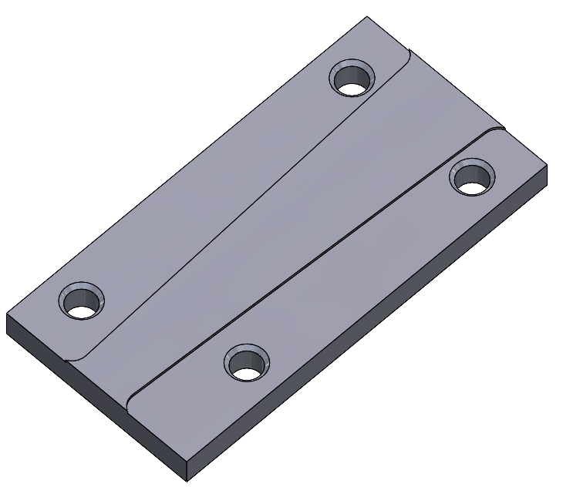
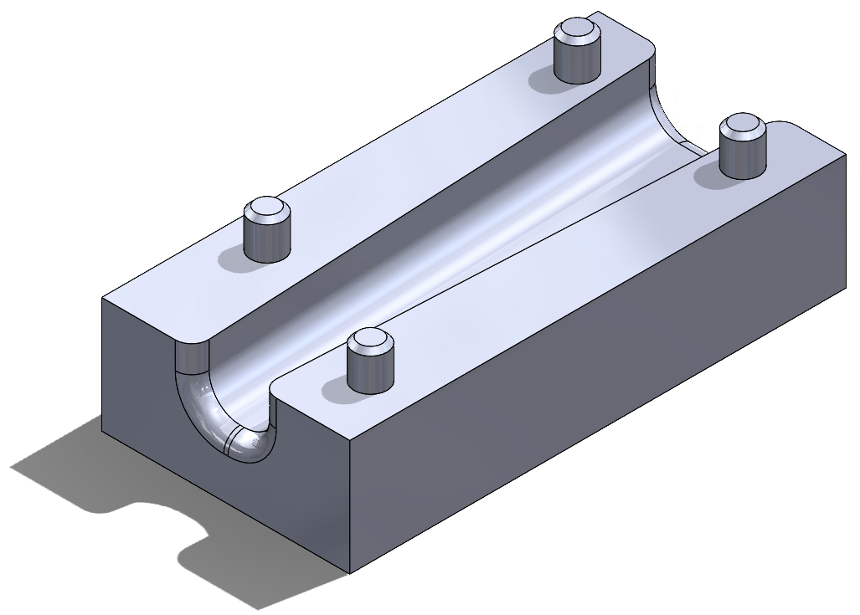
Background and Problem:
Lid
B.U.M.E.S (Boston University Manufacturing Execution Software) is a fully automated system for manufacturing and can be used for assembling a cord organizer (also known as a Cordganizer), consisting of two distinct parts:
● Lid Piece (1.5” x 3” x 0.25” Polycarbonate)
● Base Piece (1.5” x 3” x 1” HDPE)
Current Operation Time of BUMES
~24 minutes per cycle of two assemblies
~4 minutes (real milling time)
Base
Boston University College of Engineering
~6 minutes (real milling time)

Slide 3
BUMES
Vision
Main goal:
Increase the throughput by reducing the overall process time of the Cordganizer
Aim 1: Optimize the cordganizer CAD/CAM
Aim 2: Optimize UR and BUMES scripts
Main goal:
Integrated vision with BUMES
Aim 3: Use camera and UR to sort assembled Cordganizers into two different bins based on their color.
Sorting process using vision and OpenCV library
Boston University College of Engineering
Notes:
Gaella

Slide 4
Project Scope And Goal
Optimize BUMES to enhance throughput and utilize vision system as a post-manufacturing process that automatically identifies and sorts machined parts into two distinct categories based on color.
Boston University College of Engineering
Notes:
Aniruddha reducing any inefficiencies in movement or processing time

Slide 5
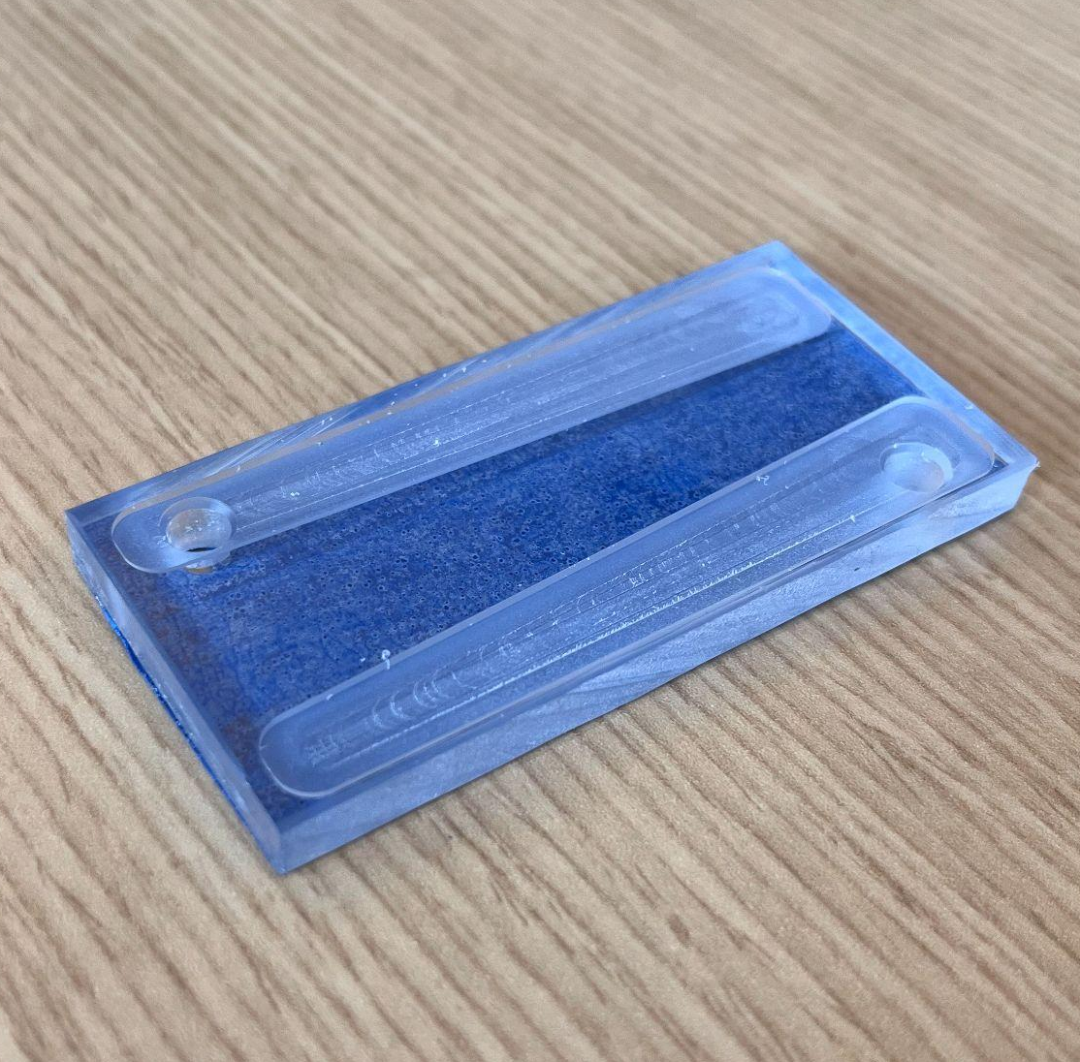
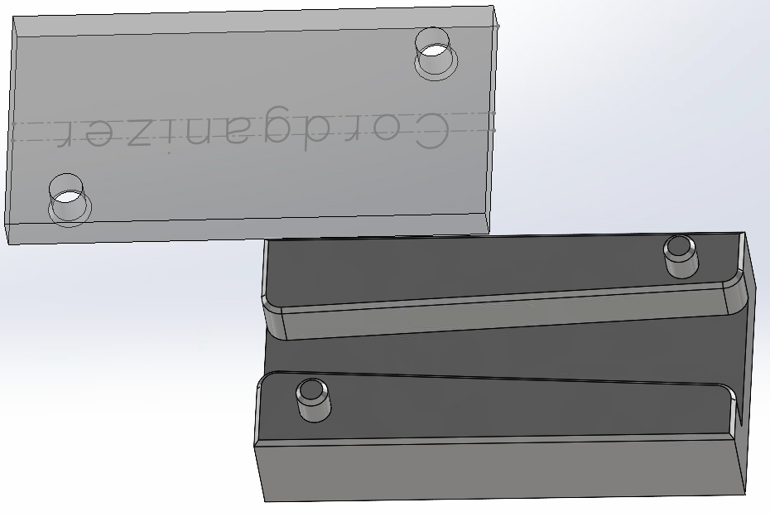
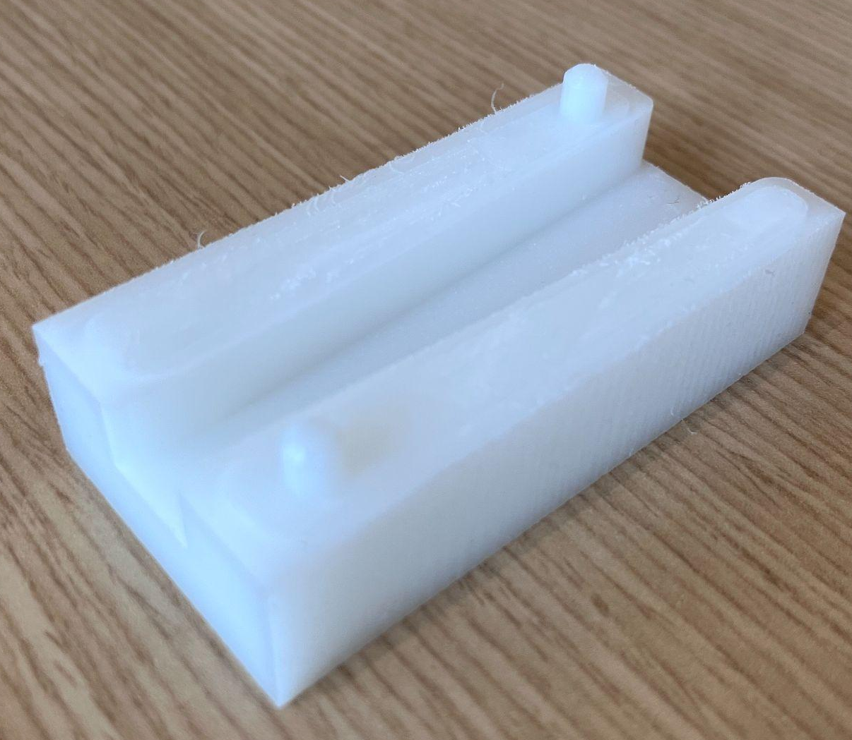
Aim 1: CAD - Design Iterations
Final CAD Models
Boston University College of Engineering
Notes:
Shrijit

Slide 6
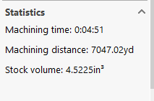
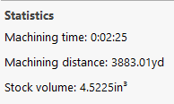
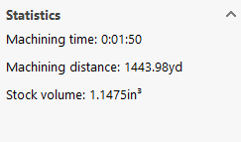
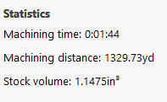
Aim 1: CAM - Body Lid
A rounded slot is included on the top surface of the central raised section
Two cylindrical pegs
Diameter of the peg - 0.20 in
Depth of cutting - 3.5 in for the channel
Cutting feed rate - 35.2 in/min
Number of tool change - 2
Diameter of the hole - 0.205 in
Depth of the slot - 0.03 in
Number of tool change - 1
Old New
New
Old
Figure: CAM Simulation – Lid Machining Time
Figure: CAM Simulation – Body Machining Time
Boston University College of Engineering
[3] Most Up to Date Cordganizer CAD/CAM/GCode Files
Notes:
Annirudh

Slide 7
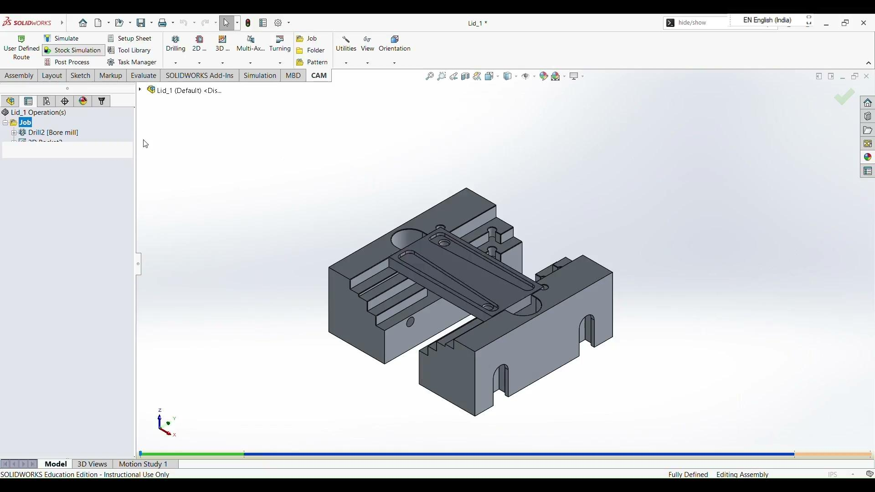
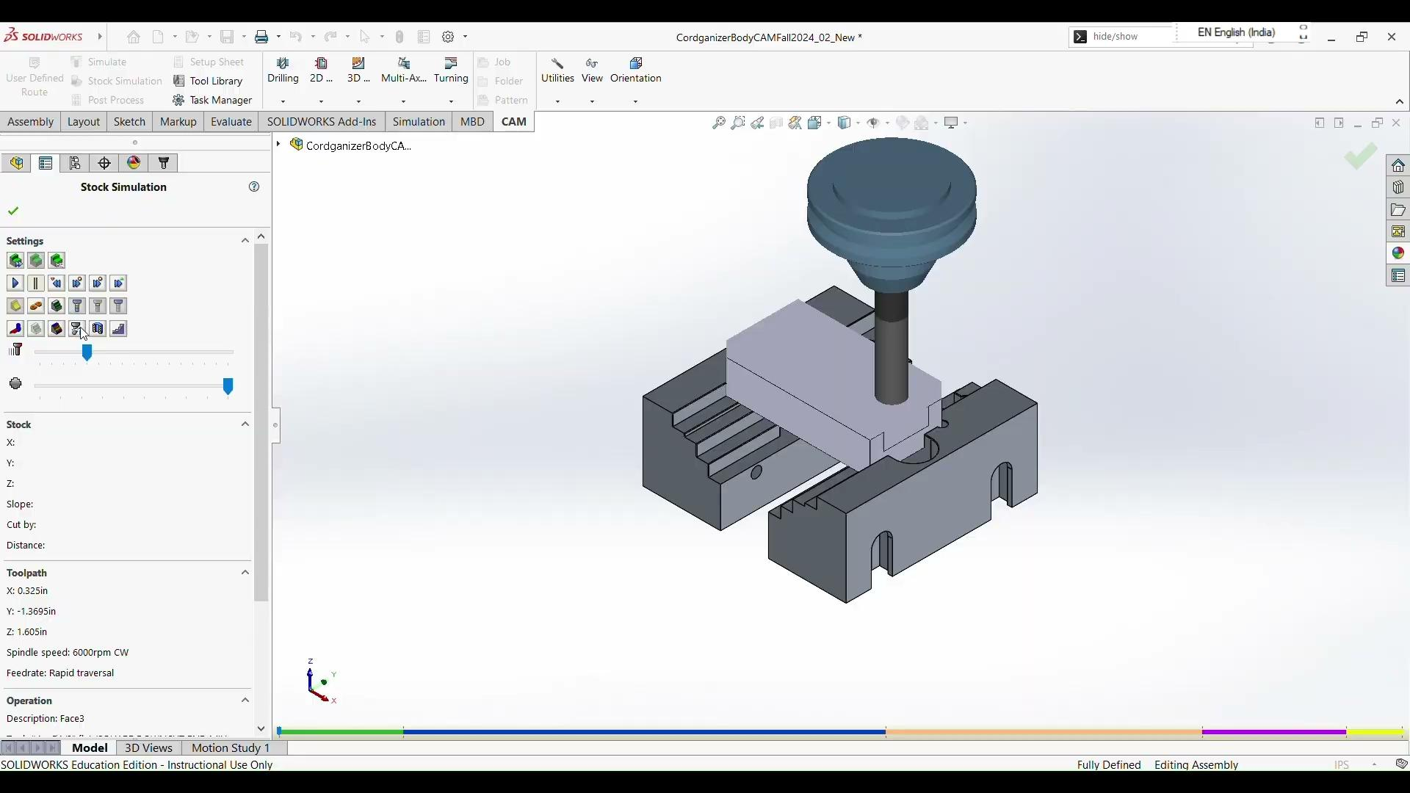
CAM Videos
Lid Part Machining – CAM Simulation Video
Body Part Machining – CAM Simulation Video
Boston University College of Engineering
[3] Most Up to Date Cordganizer CAD/CAM/GCode Files
Notes:
Annirudh

Slide 8
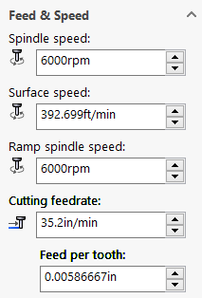
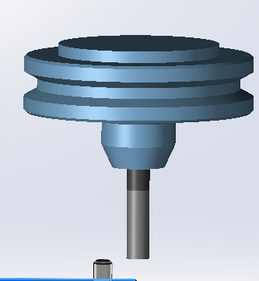
CAM Calculations
Feed rate(F_{m} ) = n * z * F_{t}
where,
F_{int​} =F_{m}= Feed rate (in/min) = 52.8 in/min n = 6000RPM z = number of teeth = 1 F_{t​} = feed per tooth (in/tooth)
h = ratio of the height = 0.667in
Calculating the initial feed per tooth:
F_{t-original​}= F_{m-int} / n *z = 52.8/ 1 *6000 =0.0088 in/tooth
Calculating the new feed per tooth:
F_{t-new} = h * F_{t-original​} = 0.667 * 0.0088 = 0.0058696 in/tooth
Calculating the new feed rate:
F_{m-new} = 6000 * 1 * 0.0058= 35.2 in/min
Tool
Feed and Speed Parameters for CNC Machining

Slide 9
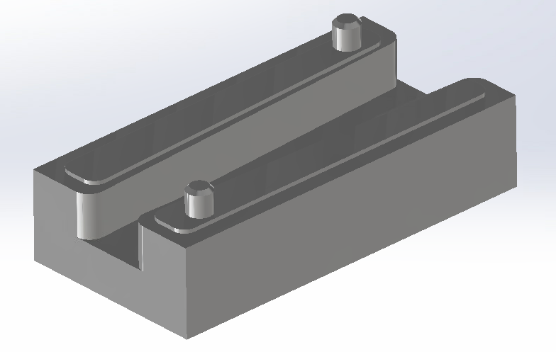
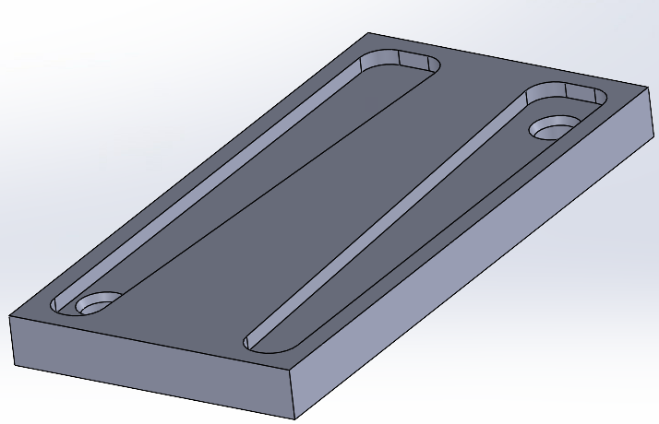
 | Old Lid | New Lid |  | Old Body | New Body
CAD
CAM Processes | Facing, Four Holes, Four Chamfers | Pocket Milling, Two Holes, Two Chamfers |  | Step-Down Milling (2 passes), Deep Pocket Milling (2 passes, Cord Channel), Four Chamfers | Roughing (1 pass), Deep Pocket Milling (1 pass, Cord Channel), Slot Perimeter, Two Chamfers
Time | 3 minutes, 45 seconds ± 3 seconds | 1 minute, 45 seconds ± 3 seconds |  | 6 minutes, 24 seconds ± 3 seconds | 3 minutes, 16 seconds ± 3 seconds
Boston University College of Engineering
Notes:
Shrijit

Slide 10
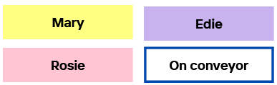
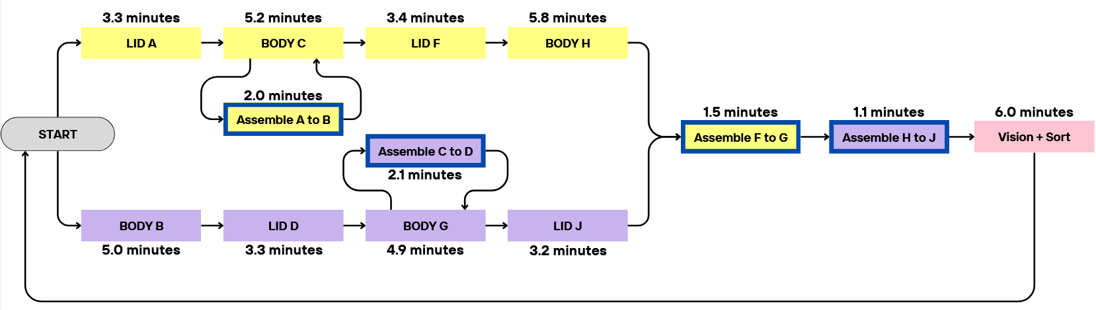
Aim 2: BUMES Process
1 BUMES cycle → 4 cordganizers + vision + sorting
Total time: 24.6 minutes
13 individual programs to achieve system optimization
Letter and number code in script name to decrease confusion
Alternate machining
Could run infinitely after including Rosie+Vision
Boston University College of Engineering
Notes:
The original cordganizer setup was approximately the same time for only two assemblies!! not even including the vision

Slide 11
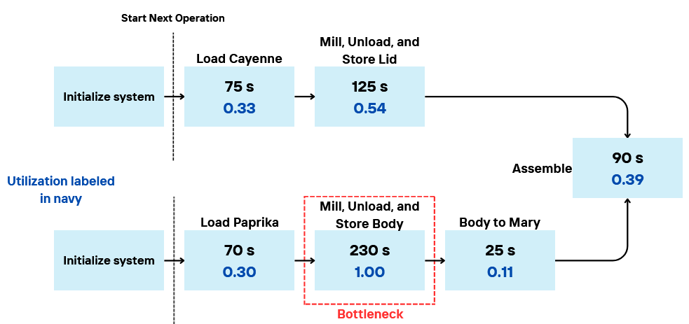
New Routing Diagram
Simplifying Assumptions
Round manufacturing steps to nearest 5s interval.
Neglect step 1 – Initialize system (<5s)
Boston University College of Engineering
Notes:
The original cordganizer setup was approximately the same time for only two assemblies!! not even including the vision

Slide 12
Improvements
Old Cordganizer Process
Mfg, Operation Time: 11.9 minutes/Cordganizer
40% value added time
Throughput Time: 11.9 minutes/Cordganizer
New Cordganizer Process
Mfg. Operation Time: 10.3 minutes/Cordganizer
72% value added time
Throughput Time: 7.2 minutes/Cordganizer
vs.
[5]
~24 minutes to make and assemble 2
19.4 minutes to make and assemble 4* → 150% increase
*alternate machining achieved steady state and decreased overall time

Slide 13



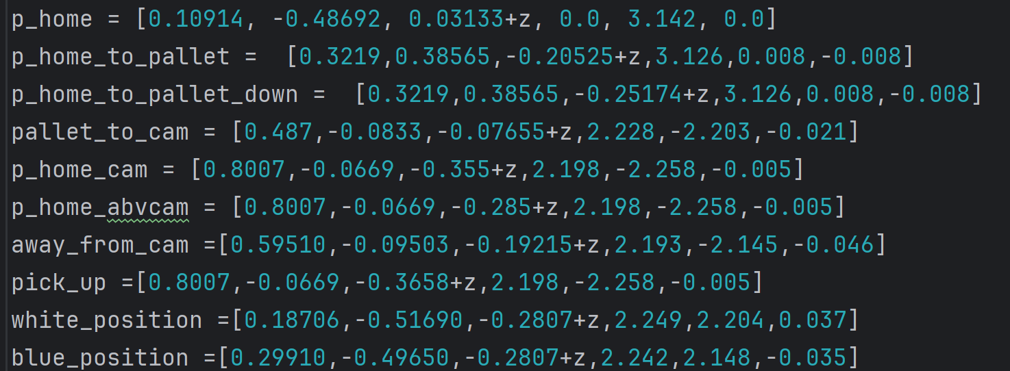
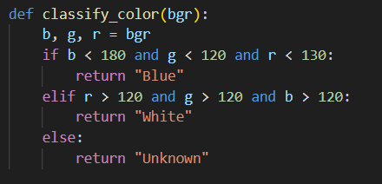

Aim 3: Vision-Based Part Identification and Sorting
Connection to UR and gripper
Gripper’s switch
Camera toggle
Pose to joints conversion
Waypoints (x, y, z, rx, ry, rz)
Colour classification
Boston University College of Engineering

Slide 14
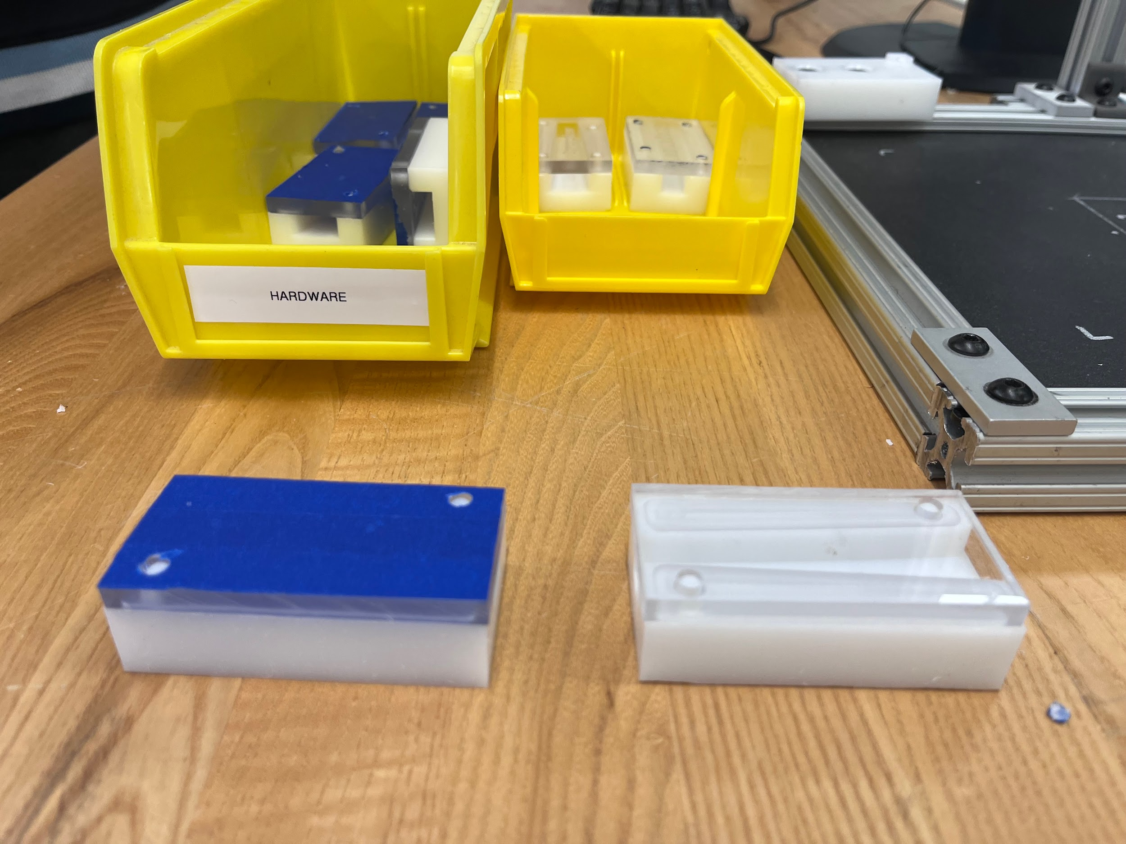
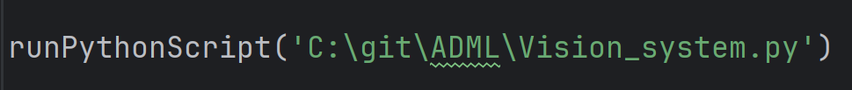
Aim 3: Vision-Based Part Identification and Sorting
_mesProcess.py → _mesVision_test.py → Vision_system.py
Sorting bins

Slide 15
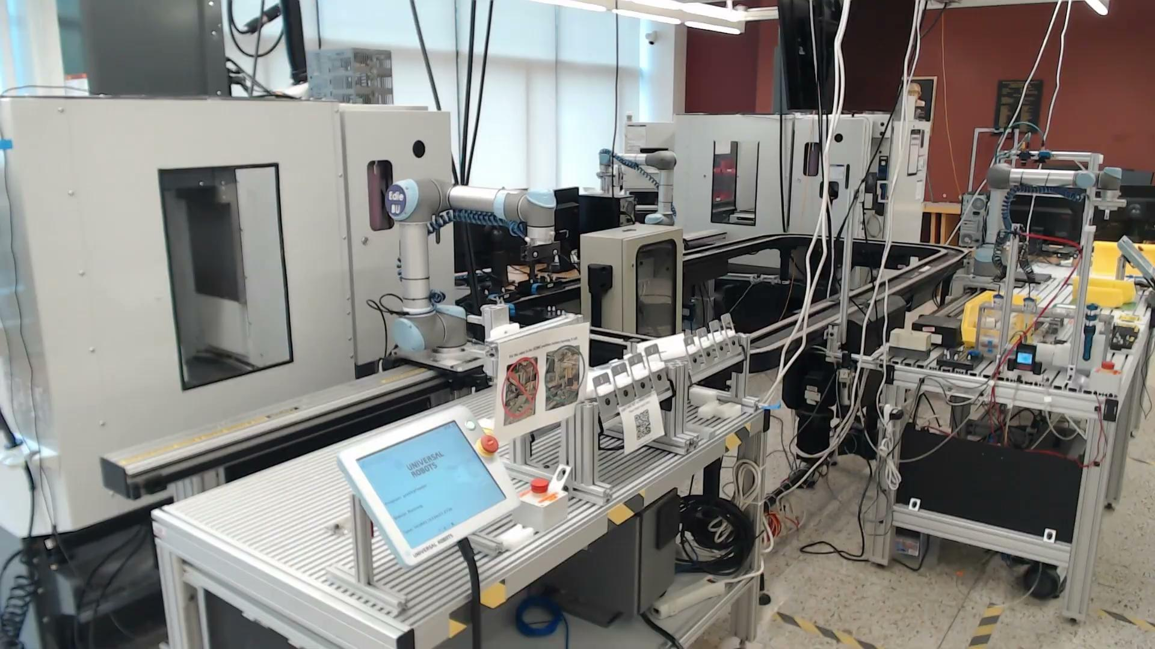
Video of the entire process (BUMES+VISION)

Slide 16
Limitations and Future Work
Limitations:
Camera and lighting issues
No built in wait() capability between operations
Future Work:
Optimize CAM for exclusively snap fit; reduce milling times
Eliminate burring; add finishing passes or decrease milling feed
Implement more vision features (size, holes, details etc)
Include data collection and tracking
Boston University College of Engineering

Slide 17
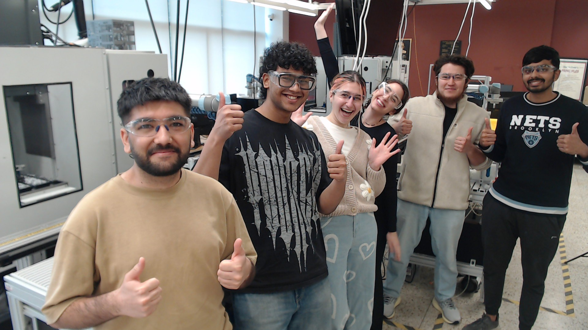
They said we couldn’t do it, so we did:)

Slide 18
References
[1]: Lab 4: Computer Integrated Manufacturing (CIM)
[2]: BUMES Runs Data
[3]: Most Up to Date Cordganizer CAD/CAM/GCode Files
[4]:Feed Rate in CNC Machining
[5]: Cordganizer CIM I Table and Routing Diagram Construction
Thank you to Adam, Ben, Megha, and the other BUMES teams!
Boston University College of Engineering

